Slide 1



Diversity & Inclusion
View in Power BI
Last data refresh:
3/18/2024 7:15:42 PM UTC
Downloaded at:
3/18/2024 7:17:54 PM UTC

Slide 2
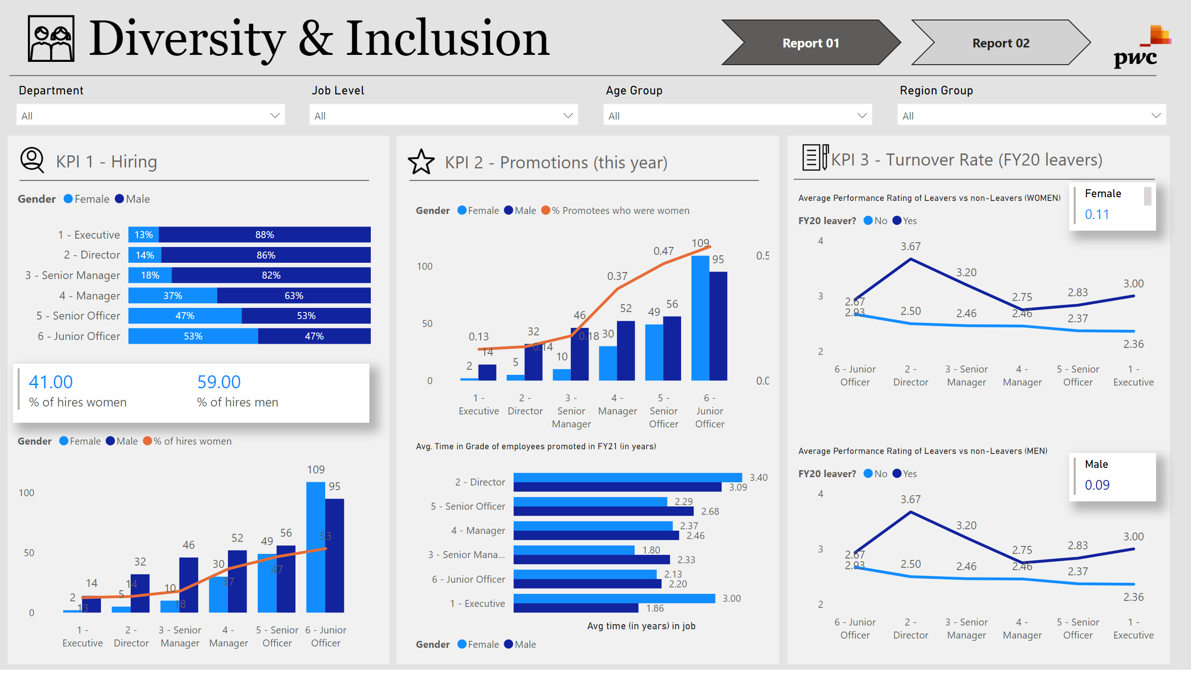
Report 01
Notes:
textbox
No alt text provided
image
No alt text provided
basicShape
No alt text provided
slicer
No alt text provided
slicer
No alt text provided
slicer
No alt text provided
slicer
No alt text provided
hundredPercentStackedBarChart
No alt text provided
textbox
No alt text provided
image
No alt text provided
multiRowCard
No alt text provided
lineClusteredColumnComboChart
No alt text provided
basicShape
No alt text provided
Avg. Time in Grade of employees promoted in FY21 (in years)
No alt text provided
lineClusteredColumnComboChart
No alt text provided
image
No alt text provided
textbox
No alt text provided
basicShape
No alt text provided
basicShape
No alt text provided
basicShape
No alt text provided
multiRowCard
No alt text provided
multiRowCard
No alt text provided
Average Performance Rating of Leavers vs non-Leavers (WOMEN)
No alt text provided
Average Performance Rating of Leavers vs non-Leavers (MEN)
No alt text provided
textbox
No alt text provided
basicShape
No alt text provided
image
No alt text provided
basicShape
No alt text provided
image
No alt text provided
pageNavigator
No alt text provided

Slide 3
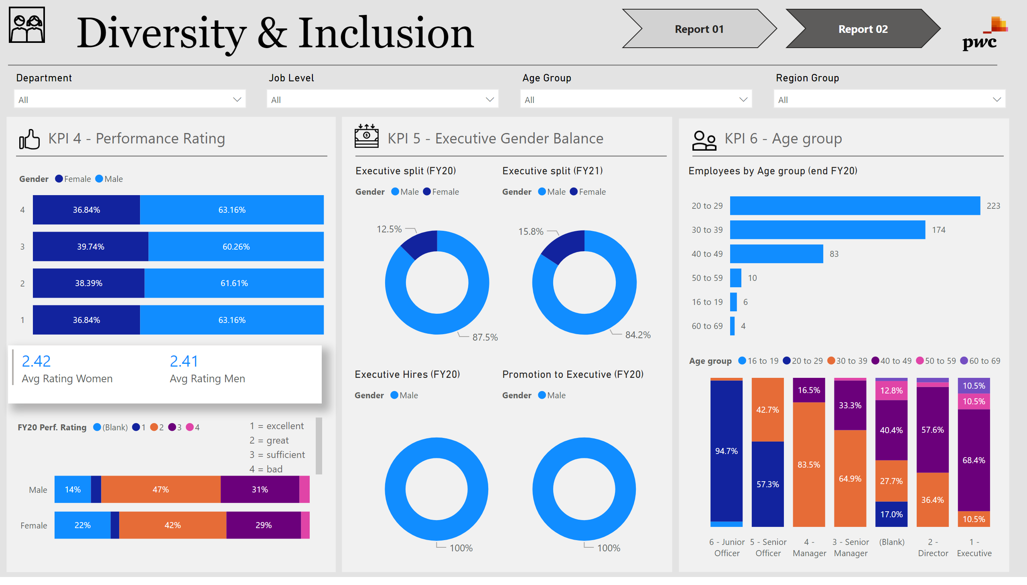
Report 02
Notes:
textbox
No alt text provided
basicShape
No alt text provided
basicShape
No alt text provided
basicShape
No alt text provided
textbox
No alt text provided
multiRowCard
No alt text provided
hundredPercentStackedBarChart
No alt text provided
image
No alt text provided
image
No alt text provided
image
No alt text provided
basicShape
No alt text provided
image
No alt text provided
slicer
No alt text provided
slicer
No alt text provided
slicer
No alt text provided
slicer
No alt text provided
basicShape
No alt text provided
textbox
No alt text provided
basicShape
No alt text provided
textbox
No alt text provided
basicShape
No alt text provided
hundredPercentStackedBarChart
No alt text provided
textbox
No alt text provided
Executive split (FY21)
No alt text provided
Executive split (FY20)
No alt text provided
Executive Hires (FY20)
No alt text provided
Promotion to Executive (FY20)
No alt text provided
image
No alt text provided
Employees by Age group (end FY20)
No alt text provided
hundredPercentStackedColumnChart
No alt text provided
image
No alt text provided
pageNavigator
No alt text provided

